Slide 1
Diabetes Management through Informatics
Team – H8
Pranay Yellamandala
Anil Varikuppala
Vivek Reddy

Slide 2
INTRODUCTION
Diabetes is a common chronic illness with significant health implications.
Patients face complex tasks like blood glucose monitoring, medication adherence, and lifestyle changes.
Our initiative leverages Business Intelligence (BI) technology to enhance diabetes care.

Slide 3
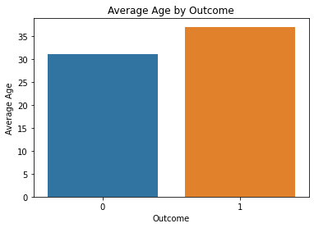
POWER BI DASHBOARD 1 :
Bar plot highlights age, diabetes, and glucose levels.
Noticeable average age difference of 6-7 years between diabetes groups.
Suggests a potential link between aging and diabetes risk.
Aligns with known epidemiological trends.

Slide 4
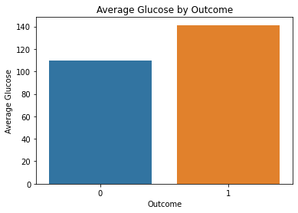
POWER BI DASHBOARD 2 :
Significant difference in blood glucose levels.
Diabetics exhibit around 30 units higher glucose.
Reinforces common knowledge of elevated glucose in diabetes.
Emphasizes the crucial role of glucose in diagnosis.

Slide 5
Comprehensive View of Age and Glucose
Significant difference in blood glucose levels.
Diabetics exhibit around 30 units higher glucose.
Reinforces common knowledge of elevated glucose in diabetes.
Emphasizes the crucial role of glucose in diagnosis.

Slide 6
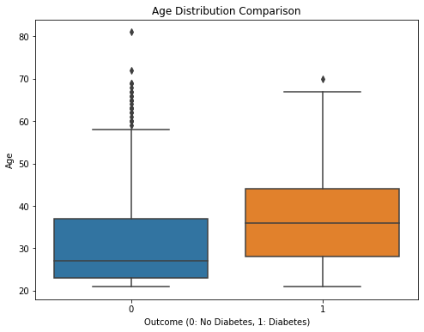
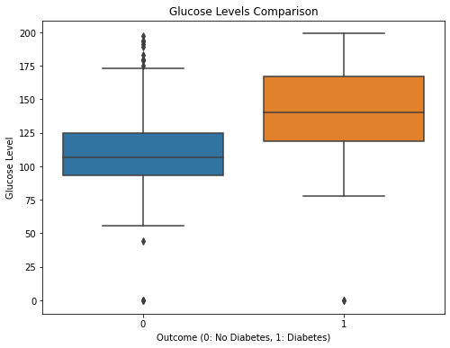
POWER BI DASHBOARD 3 :
Valuable insights for clinical decision-making.
Directs focused screenings for older age groups.
Facilitates early detection and intervention.
Emphasizes the importance of routine monitoring for diabetes management.

Slide 7
Rationale Behind The Name
Presenting "GluGuard": An easy-to-use app for managing diabetes. Justification: "GluGuard" emphasizes our dedication to user-friendly diabetes management by combining guardianship and glucose monitoring.

Slide 8
3 Main Features and Impact
Feature 1:- Continuous Glucose Monitoring (CGM) Integration
Feature Description: Integration of CGM for real-time glucose monitoring.
Potential Impact: Continuous monitoring, reduced fingerstick tests, better decision-making.
Feature 2:- Insulin Dosing Recommendations
Feature Description: Machine learning for personalized insulin dosing.
Potential Impact: Informed decisions, and improved glycemic control.
Feature 3:- Nutrition and Activity Tracking
Feature Description: Comprehensive tracking of nutrition and activity.
Potential Impact: Understanding lifestyle impact, and making healthier choices.

Slide 9
Block Diagram
CGM Integration
Real-Time Glucose Monitoring
Continuous Glucose Monitoring
Insulin Dosing Recommendations
Machine Learning for Personalised Insulin Dosing
Informed Decision
Improved Glycemic Control
Life Style Tracking
Comprehensive Tracking of Nutrition and Activity
Nutritional Activity Tracking

Slide 10
Incorporating Cutting-Edge AI in Diabetes Management.
1. AI- Enhanced Diabetes Care: Predicting Levels and Personalized Guidance.
AI for Diabetes Monitoring analyzes a diabetic's data using sophisticated models like LSTM or RNN. It uses information from previous meals, exercise, and insulin administration to forecast blood sugar levels in the future. Advantages include encouraging patients to follow their care plan, individualized food and insulin recommendations, and early detection of changes in blood sugar levels, all of which contribute to successful diabetes control.

Slide 11
2. AI Drug Compliance:
Model: NLP for deciphering messages from patients.
Use Case: Examining prescription feedback from patients. AI recognizes trends, assesses emotions, and makes customized recommendations for substitutes or learning materials. Benefits: Increase patient satisfaction, increase adherence with tailored support, and improve health outcomes by addressing issues early.

Slide 12
Thanks !!!

